Slide 1
Markit Technovation 2016
The Science of Finance
XAP – XML Automated Parser
The Concept Crew Team
GAURAV AGARWAL
NITIN SINGH
PARAG GARG

Slide 2

IDEA DESCRIPTION
Markit is a data oriented company and almost all products revolve around parsing of raw data, enriching and finally distributing.
Problem
At present all team tries to achieve the same business goal, using different technologies in a different ways.
Solution
Our goal is to provide the common open source platform for parsing & loading which can be used across Markit.

Slide 3
PROBLEM --- MANUAL INTERVENTION
Creation of new maven project
Generation of JAXB classes from XSD
Creating new POJO classes/API
Creating SQL scripts
Creating new Database Model
Tables, Sequence, Primary Key, Foreign Key etc
At present, no tool exist to map Parent – Child relationship of XSD into Relational database scripts.
Creating new Parser classes for reading XML based on XSD
Writing new Loader framework for CRUD operations

Slide 4

SOLUTION -- FULL AUTOMATION
Creation of new maven project on the fly
  With default configuration & Customizable
Creation of JAXB classes on the fly from given XSD
  Further used for Marshaling/Unmarshalling
Creation of POJO classes/API from given XSD
Generation of SQL scripts from XSD
  Converting Parent – Child relationship into Relational database scripts
  Options to create scripts based on different database like Oracle, MS SQL
Login to Database for Table, sequence etc creation
  Automatically mapping 1-to-1 and 1-to-Many relationship
Generate Parser for reading and writing XMLs
Generate generic Loader Framework within new Maven project for CRUD operations

Slide 5

BENEFITS
Reducing the cost of project by reducing Development time, which was required for creating any new Parsing framework.
Common framework across Markit
  Easier to maintain
  Developers working across different products can easily contribute in performance etc improvement.
  Common coding standards can be easily implemented
  Cross- team coding benefits can be easily adopted.
This tool can be used by non-technical resource also like analyst, to parse the XML for analysis purpose.
This tool is using all open source technologies and hence no licensing cost is incurred.

Slide 6

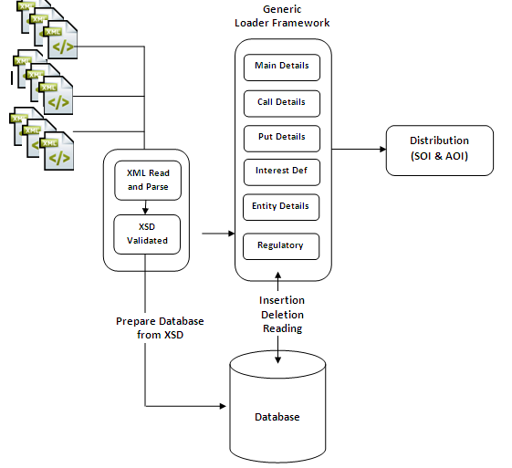
ARCHITECTURE

Slide 7

Subsequent Steps
This framework can be further expanded to include parsing of other formats like CSV, Delimited etc.
Can be further expanded to include other NoSQL databases also like MongoDB, CASSANDRA etc.
Can be further expanded for Common Business rule development using open source technologies like Drools etc
Fully automation to ease the usage.
This tool can be further expanded to become true ETL tools
Can be further expanded for distribution purpose also

Slide 8

The Concept Crew Team
GAURAV AGARWAL
NITIN SINGH
PARAG GARG

